Slide 1
ARM INSTRUCTION SET

Slide 2
Instructions
Instructions process data held in registers and access memory with load and store registers
Classes of instructions:
  Data processing
  Branch instructions
  Load-store instructions
  Software interrupt instructions
  Program status register instructions

Slide 3
ARM Data types
Word is 32 bits long
Word can be divided into four bytes
ARM addresses can be 32 bit long
Address refers to byte
  Address 4 starts at byte 4
Can be configured at power up as little endian or big endian mode

Slide 4
Data Processing
Manipulate data within registers
  MOVE instructions
  Arithmetic instructions
    Multiply instructions
  Logical instructions
  Comparison instructions
Suffix S on data processing instructions updates flags in CPSR

Slide 5
Data processing instructions
Operands are 32 bit wide; comes from registers or specified as literal in the instruction itself
Second operand send to ALU via barrel shifter
32-bit result placed in register; long multiply instruction produces 64 bit result

Slide 6
Move instruction
MOV Rd, N
  Rd: Destination register
  N: can be an immediate value or source register
  Example: mov r7, r5
MVN Rd, N
  Move into Rd not of the 32-bit value from source

Slide 7
Using Barrel Shifter
Enables shifting 32 bit operand in one of the source registers left or right by a specific no. of positions within the cycle time of instructions
Basic barrel shifter operations
  Shift left, shift right, rotate right
Facilitates fast multiply, division and increases code density
Example : mov r7, r5, LSL #2

Slide 8
Arithmetic instructions
Implements 32 bit addition and subtraction
3 operand form
Examples
SUB r0, r1, r2
Subtract value stored in r2 from that of r1 and store in r0
SUBS r1, r1, #1
Subtract 1 from r1 and store result in r1 and update Z and C flags

Slide 9
With Barrel shifter
Use of barrel shifter with arithmetic and logical instructions increases the set of possible available operations
Example
  ADD r0, r1, r1 LSL #1
  Register r1 is shifted to the left by 1, then it is
  added with r1 and the result (3 times of r1) is
  stored in r0.

Slide 10
Multiply instructions
Multiply contents of a pair of registers
  Long multiply generates 64 bit result
Examples
  MUL r0, r1, r2
  UMULL r0, r1, r2, r3
Number of cycles taken for execution of multiply instruction depends upon processor implementation

Slide 11
Logical instructions
Bit wise logical operations on the two source registers
  AND, OR , Ex-OR, bit clear
  Example : BIC r0, r1, r2
    r2 contains a binary pattern where every binary 1 in r2 clears a corresponding bit location in register r1
    Useful in manipulating status flags and interrupt masks

Slide 12
Compare instructions
Enables comparison of 32 bit values
  Updates CPSR flags but do not affect other registers
  Examples
    CMP r0, r9
      Flags set as a result of r0 - r9
    TEQ r0, r9
      Flags set as a result of r0 ex-or r9
    TST r0, r9
      Flags set as a result of r0 & r9

Slide 13
LOAD/STORE INSTRUCTIONS
Transfers data between memory and processor registers
  Single register transfer
    Data types supported are signed and unsigned
    words(32 bits), half-words and bytes
  Multiple-register transfer
    Transfers multiple registers between memory and the processor in a single instruction
  Swap
    Swap content of a memory location with the contents of the register

Slide 14
Single Transfer instructions
Load and Store data on a boundary alignment
  LDR, LDRH, LDRB;
    Load (word, half-word, byte)
  STR, STRH, STRB;
    Store (word, half-word, byte)
Supports different addressing modes:
  Register indirect: LDR r0, [r1]
  Immediate: LDR r0, [r1, #4]
    12 bit offset added to the base register
  Register operation: LDR r0, [r1, -r2]
    Address calculated using base register and another register

Slide 15
More addressing modes
Scaled
  Address is calculated using the base address register and a barrel shift operation
Pre and Post indexing
  Pre-index with write back: LDR r0, [r1, #4]!
    Updates the address base register with new address
  Post index: LDR r0, [r1], #4
    Updates the address register after address is used

Slide 16
Example
Pre-indexing with write back
LDR r0, [r1, #4]!
  Before instruction execution
    r0 = 0x00000000 r1 = 0x00009000
    Mem32[0x00009000] = 0x01010101
    Mem32[0x00009004] = 0x02020202
  After instruction execution
    r0 = 0x02020202
    r1 = 0x00009004

Slide 17
Multiple Register Transfer
Load-store multiple instructions transfer multiple register contents between memory and the processor in a single instruction
More efficient – for moving blocks of memory, saving and restoring context and stack
These instructions can increase interrupt latency
  Usually instruction executions are not interrupted by ARM

Slide 18
Multiple Byte Load-Store
Any subset of current bank of registers can be transferred to memory or fetched from memory
  LDM
  STM
The base register Rn determines source or destination address
LDM{cond}address-mode Rn{!},reg-list{^}
{r0,r1,r4-r6,pc}

Slide 19
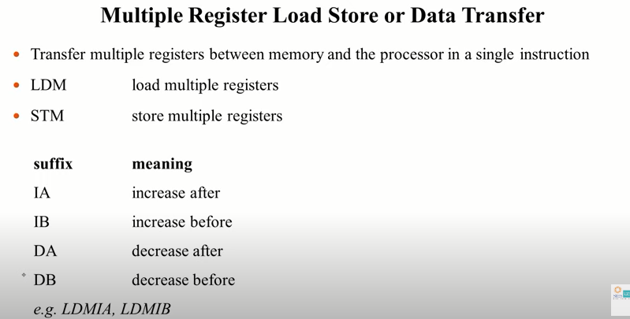

Slide 20
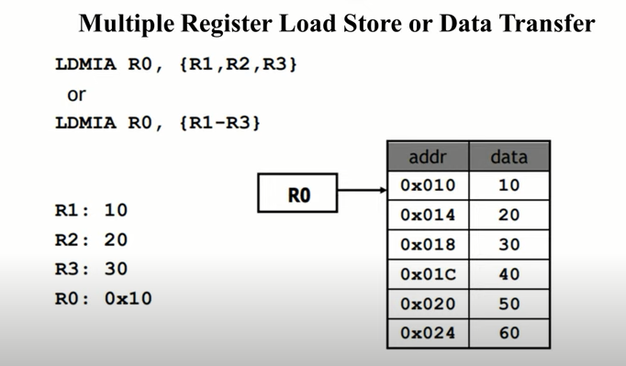

Slide 21
Stack Processing
ARM architecture uses the load store multiple instructions to carry out stack operations
Ascending –stack grows towards higher memory address
Descending –stack grows towards lower memory address
Full – sp points to the last item on the stack
Empty - sp points after the last item on the stack

Slide 22
Modes of Stack Operation
ARM Multiple register transfer instructions support
  Full ascending: grows up, SP points to the highest address containing a valid item
  Empty ascending: grows up, SP points to the first empty location above stack
  Full descending: grows down, SP points to the lowest address containing a valid data
  Empty descending: grows down, SP points to the first location below stack

Slide 23
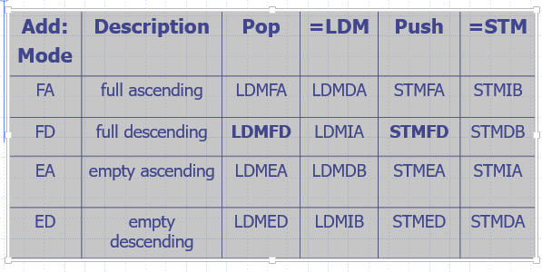
Addressing Methods for Stack Operations

Slide 24
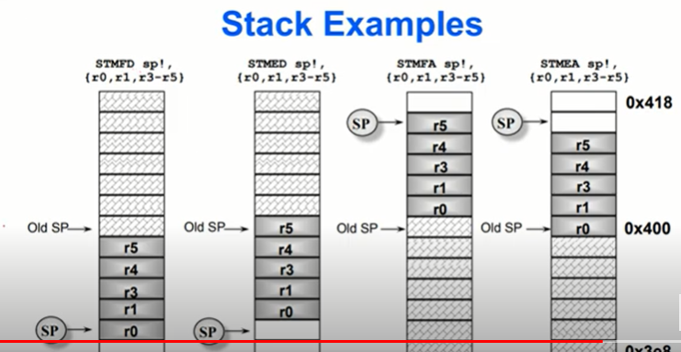

Slide 25
SWAP INSTRUCTION
Special case of load store instruction
Swap instructions
  SWP: swap a word between memory and register
  SWPB: swap a byte between memory and register

Slide 26
Control Flow instructions
Branch instructions
Conditional branches
Conditional execution
Branch and link instructions
Subroutine return instructions

Slide 27
Branch instruction
Branch instruction: B label
  Example: B forward
  Address label is stored in the instruction as a signed pc-relative offset
Conditional Branch: B <cond> label
  Example: BNE loop
  Branch has a condition associated with it and executed if condition codes have the correct value

Slide 28
Conditional Execution
An unusual feature of ARM instruction set is that conditional execution applies not only to branches but to all ARM instructions
Example: ADDEQ r0, r1, r2
  Instruction will only be executed when the zero flag is set to 1

Slide 29
Advantages of conditional execution
Reduces the number of branches
  Reduces the number of pipeline flushes
  Improves performance of the code
Increases code density
Whenever the conditional sequence is 3 instructions or fewer (smaller and faster) to exploit conditional execution than to use a branch

Slide 30
Branch and Link
Perform a branch, save the address following the branch in the link register, r14
  Example: BL subroutine
Notes:
R13 is stack pointer, push r14 (link register) and some work registers (r0-r2) in the case of nested subroutine.

Slide 31
Subroutine return instructions
No specific instructions
Example:
sub …..
MOV PC, r14
Notes:
R14 is link register.

Slide 32
Software Interrupt Instruction(SWI)
A software interrupt instruction causes a software interrupt exception, which provides a mechanism for moving the processor to move from application routine to OS routines
Instruction: SWI {<cond>} SWI_number
When the processor executes an SWI instruction, it sets the program counter to the offset 0x08 in the vector table
Instruction also forces the processor mode to SVC, which allows an operating system routine to execute

Slide 33
SWI
SWI is typically executed in user mode
Instruction forces processor mode to supervisor (SVC) – this allows an OS routine to be executed in privileged mode
Each SWI has an associated SWI number which is used to represent a particular function call or feature
Parameter passing – through registers; Return value is also passed using registers

Slide 34
Example
PRE: cpsr = nzcvqift_USER
pc = 0x00008000
lr = 0x003fffff (lr = r14)
r0 = 0x12
    0x00008000 SWR 0X123456
POST: cpsr = nzcvqift_SVC
Spsr = nzcvqift_USER
pc = 0x00008004
lr = 0x00008004 (lr = r14_SVC)
r0 = 0x12

Slide 35
Program Status Register Instructions
Two instructions to control PSR directly
MRS – transfers register contents of either cpsr or spsr into a register
MSR – transfers contents of register to cpsr or spsr

Slide 36
Example
Enabling IRQ interrupt
  PRE cpsr = nzcvqIFt_SVC
      MRS r1, CPSR
      BIC r1, r1, #0x80
      MSR cpsr, r1
  POST cpsr = nzcvqiFt_SVC
  Instructions in SVC mode
Notes:
Processor mode is 5 bits

Slide 37
Coprocessor Instructions
Used to extend the instruction set
  Used by cores with a coprocessor
  Coprocessor specific operations
Syntax: Coprocessor data processing
  CDP{<cond>} cp, opcode1, Cd, Cn, Cm, {,opcode2}
    Cp represents coprocessor number between p0 to p15
    Opcode fields describes coprocessor operation
    Cd, Cn, Cm coprocessor registers
Also coprocessor register transfer and memory transfer instructions

